Slide 1

SOEN 6431 SOFTWARE MAINTENANCE AND Program Comprehension
Dr. Juergen Rilling
Week 3
Issue Trackers and Versioning Systems

Slide 2
The last 15 years: Globalization of the software Industry
became standard practice:
Software development adopts to cultural and social changes caused by
Introduction of the Internet as an enabling technology, with software being shared and published on the Internet.
Heterogeneous software ecosystems, multi programming languages, operating systems, hardware were created.
Outsourcing of parts of the software development/testing
New software development process, and technologies being available, e.g. open source movement, e-mail, wikis, etc.
Knowledge resources (people and artifacts) are no longer available “on-site” – rather distributed across organization boundaries.

Slide 3
Software repositories
Enabling technology to facilitate
Collaborative software development
Given many agile development processes – these repositories become often the sole form of system “documentation” being available.
Persistency and management of information across organization boundaries

Slide 4
Source Code Management (SCM) Requirements Space
Process Support
Distribution (LAN, WAN)
Change Request Tracking
Building
Version Management

Slide 5
Source Code Management Space
Version Management
Traceable version history
branch & merge
stable workspaces for developers and integrators
control over incorporation of concurrent changes
Configurations Management
build anywhere, anytime, with correct components
several builds running in parallel
each build can run itself in parallel
Change Request Tracking
link between change requests, solutions, releases
state changes (tested, accepted, released, etc.)
accurate status reports

Slide 6
SCM Requirements Space Cont.
Process Support
process support for submit/pickup/build&test/accept
parallel work is the rule
change set tracking
dependency tracking
Distribution
distributed teams need to be coordinated.
in case of time zone differences: difficult to do SCM informally.
databases must be connected and up-to-date.

Slide 7
The change management process

Slide 8
Change request form
The definition of a change request form is part of the CM planning process.
This form records the change proposed, requestor of change, the reason why change was suggested and the urgency of change(from requestor of the change).
It also records change evaluation, impact analysis, change cost and recommendations (System maintenance staff).

Slide 9

Defect Information
Where Found
product, release, version, hardware, os, drivers, general area
Who Found It
customer, internal, when
Description of the Defect
summary, description, how to reproduce, associated data
links to related defects or features
Triage
severity, likelihood → priority
Audit Trail
all changes to the defect data, by whom, when
State
state, owner

Slide 10
Change request form

Slide 11
Change tracking tools
A major problem in change management is tracking change status.
Change tracking tools keep track the status of each change request and automatically ensure that change requests are sent to the right people at the right time.
Integrated with E-mail systems allowing electronic change request distribution.

Slide 12
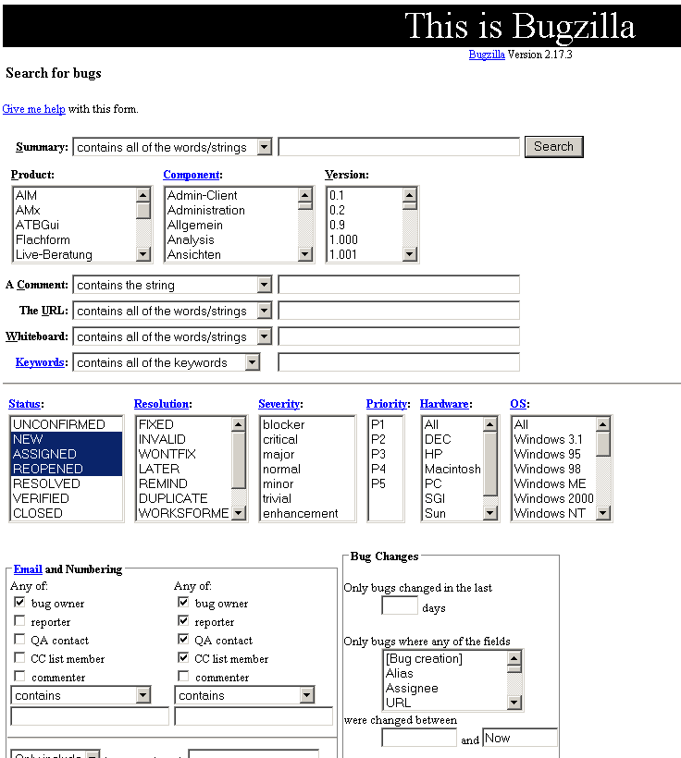

Slide 13
Guidelines for writing a good bug report
https://www.youtube.com/watch?v=Fkf565-pePs

Slide 14
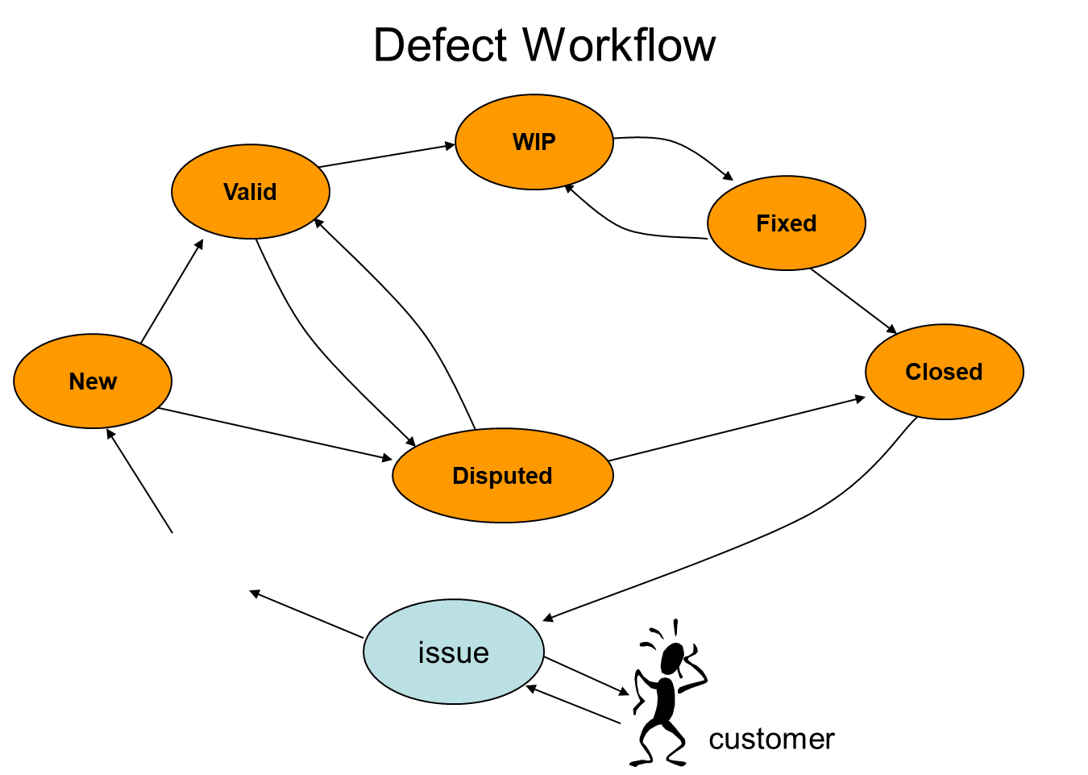

Slide 15
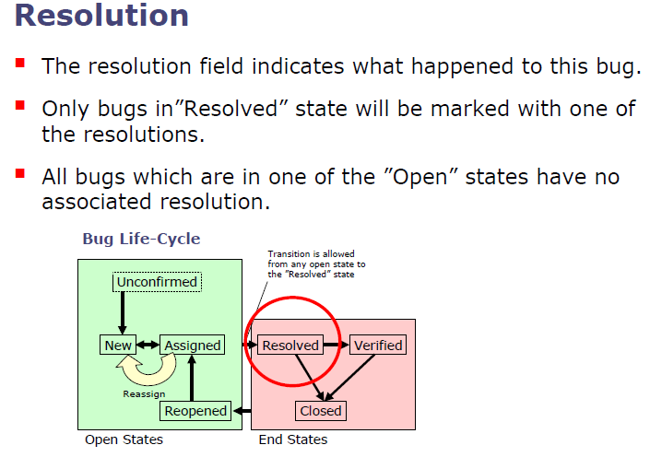

Slide 16
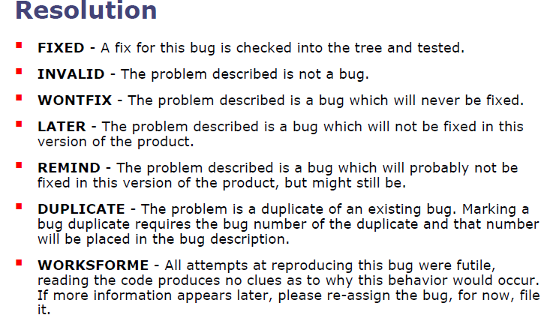

Slide 17
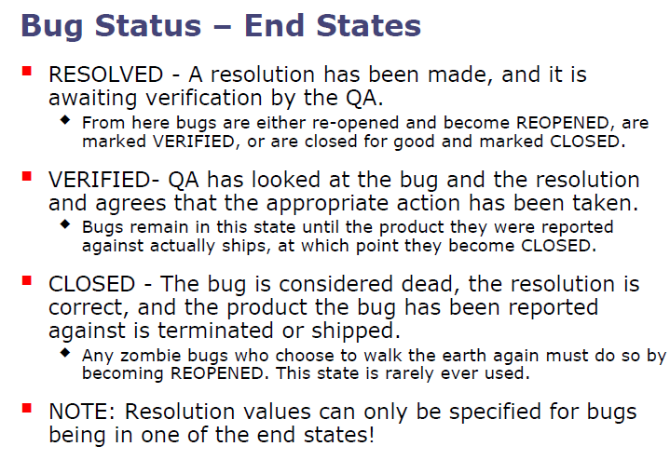

Slide 18
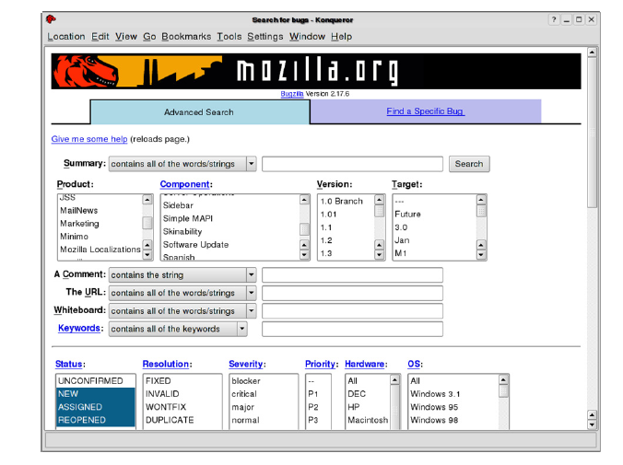
Querying the issue tracker

Slide 19
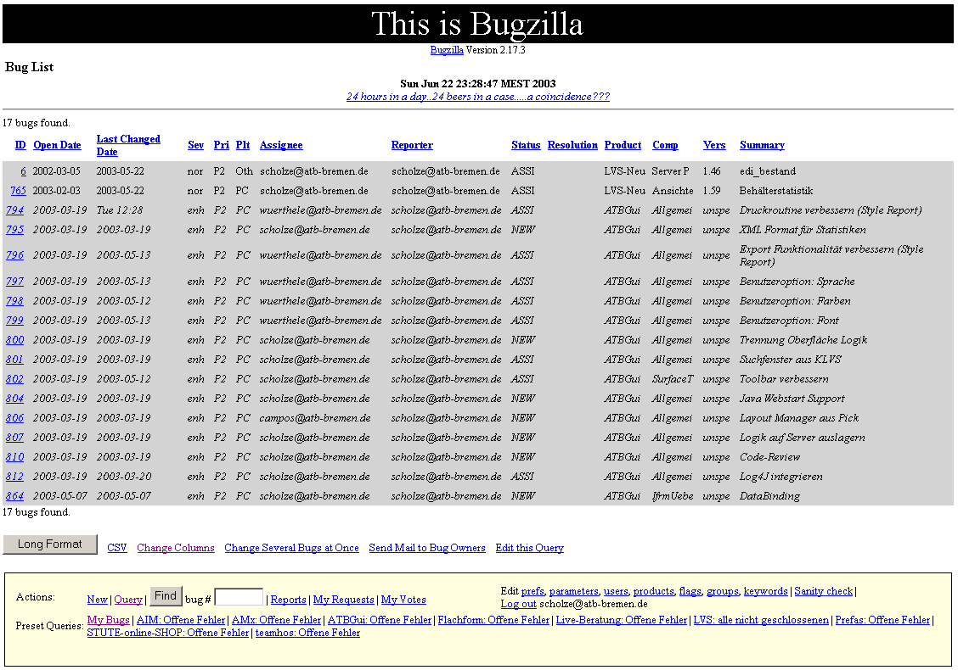
Bugzilla list

Slide 20
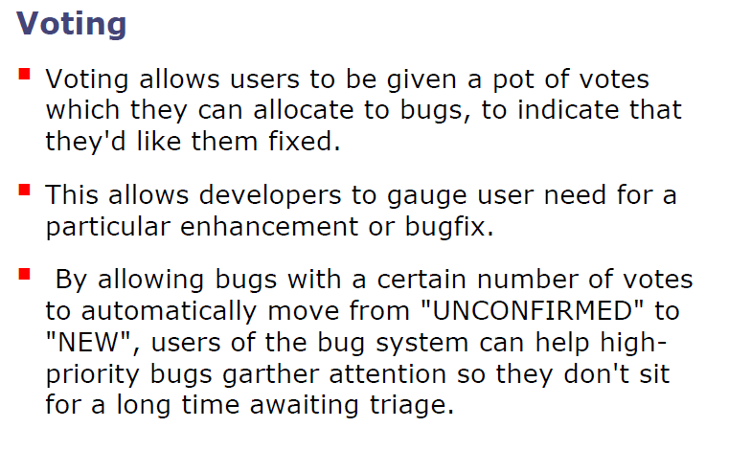
Advanced Features

Slide 21
Version Control Systems

Slide 22
Problem 1: working solo
How do you keep track of changes to your program?
Notes:
The next several slides motivate version control
Most professional tools use it, like Eclipse, DrJava, Mozilla, and pretty much everything else

Slide 23
Problem 1: working solo
Option 1: Don't bother
Hope you get it right the first time
Hope you can remember what changes you made if you didn't
(You probably won't get it right)
(Or remember)
(You will end up rewriting code)
(I do!)
Notes:
The next several slides motivate version control
Most professional tools use it, like Eclipse, DrJava, Mozilla, and pretty much everything else

Slide 24
Working solo (cont.)
Option 2: Periodically save “backups”
Save snapshots of your program in another directory or under a different name
E.g. Main.1.java, Main.2.java
Or save it in a directory by date
Problems:
Totally ad hoc
Only the programmer knows how to interpret the names
Hard to pick a version to go back to
Prone to error
No tools to help you

Slide 25
Solving problem 1
When you get something working, commit the changes
Tools allow you to revert to a previous version
Write good log messages so that you don't have to remember what changed in each version
Notes:
Problem 1: working solo, how do you keep track of changes?

Slide 26
Problem 2: moving around
After a hard day of work in the lab, you want to go home and do some work at home in the evening.
How do you know which files to copy to your home machine?
Copy everything
potentially slow
might overwrite something you did at home, but forgot to copy from home to school
Try to remember what changed
highly likely to get it wrong
Notes:
Slow: because it might be big, or you might have a bad connection.
Would be nice to only copy what has changed.

Slide 27
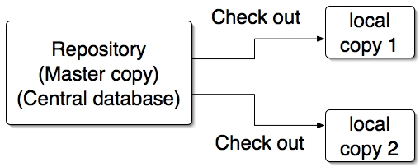
Solution: version control
Keep code in a central location (“repository”)
This is the master copy
Never directly modify this directory
Create a local copy of the repository in your account at school, on your machine at home, on your laptop...

Slide 28
Storing changes
Storing entire copy of a file on every change would require an enormous amount of disk space
Version control systems store incremental differences
The incremental differences allow the system to reconstruct previous versions

Slide 29
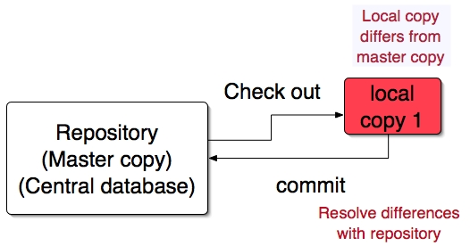
Commit
When the local copy changes, “commit” the changes to the repository

Slide 30
Problem 3: working in a team
How do you coordinate who has the authority to change a file?
Worry about it after the fact
“Hey, why is this broken?”
“My changes got overwritten!”
“You weren't supposed to change that file.”
Exchange email
“Okay, I'm going to work on A.java, so don't touch it.”
Notes:
“The whiney solution”

Slide 31
Managing concurrency
What if two (or more) people want to edit the same file at the same time?

Slide 32
Pessimistic Concurrency
Option 1: prevent it
Only allow one writeable copy of the file
Pessimistic concurrency Microsoft Visual SourceSafe (originally)

Slide 33
Optimistic concurrency
Option 2: patch up afterward
Optimistic concurrency
"Easier to get forgiveness than permission"
CVS, Perforce, Subversion

Slide 34
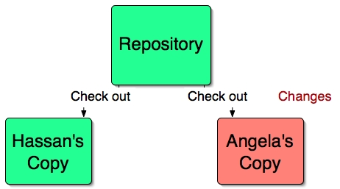
Optimistic concurrency: example
Notes:
Both check out, Angela makes some changes

Slide 35
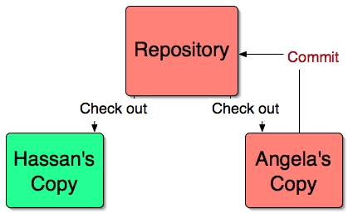
Angela commits changes
Notes:
Angela commits her changes to the master repository

Slide 36
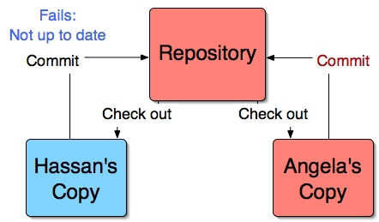
Hassan tries to commit changes
Notes:
Hassan has made changes to a different part of the repository, and tries to commit: he isn’t allowed to because the repo files are newer.

Slide 37
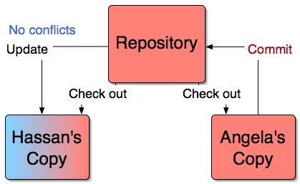
Hassan updates his version
Notes:
Hassan updates. There are no conflicts because he is working on a different part of the code.

Slide 38
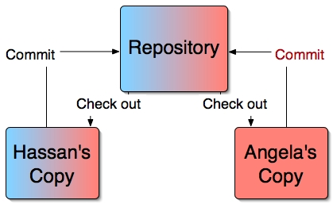
Hassan now commits
Notes:
Now Hassan can commit.
But what if there had been conflicts? That is, what if Hassan and Angela had edited the same section of code?

Slide 39
Merging

Slide 40
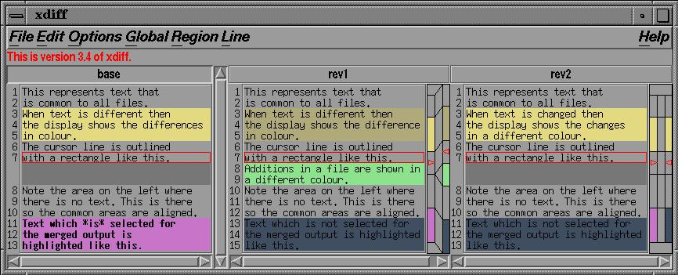
Merging Detailed view

Slide 41
More Uses of Version Control
Version control is not just useful for collaborative working, essential for quality source code development
Often want to undo changes to a file
start work, realize it's the wrong approach, want to get back to starting point
like "undo" in an editor…
keep the whole history of every file and a changelog
Also want to be able to see who changed what, when
The best way to find out how something works is often to ask the person who wrote it

Slide 42
Video: Distributed Version Control

Slide 43
Comparison
Centralized
Server with database
Clients have a working version
Examples
CVS
Subversion
Visual Source Safe
Challenges
Multi-developer conflicts
Client/server communication
Distributed
Authoritative server by convention only
Every working checkout is a repository
Get version control even when detached
Backups are trivial
Reduced merging (initially)

Slide 44
A Brief History of Git
Linus uses BitKeeper to manage Linux code
Ran into BitKeeper licensing issue
Liked functionality
Looked at CVS as how not to do things
April 5, 2005 - Linus sends out email showing first version
June 15, 2005 - Git used for Linux version control

Slide 45
Getting Started
A basic workflow
(Possible init or clone) Init a repo
Edit files
Stage the changes
Review your changes
Commit the changes

Slide 46
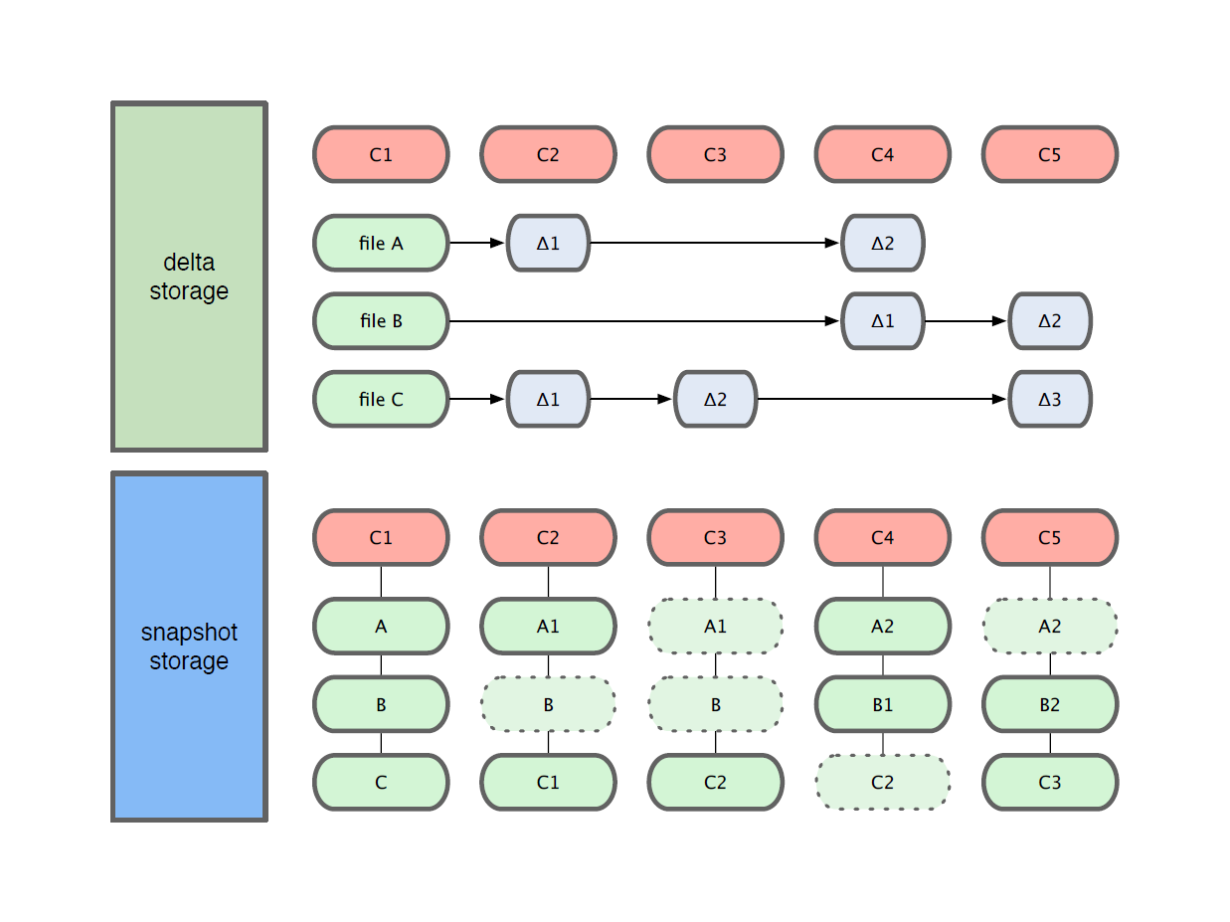
Getting Started
Git use snapshot storage

Slide 47
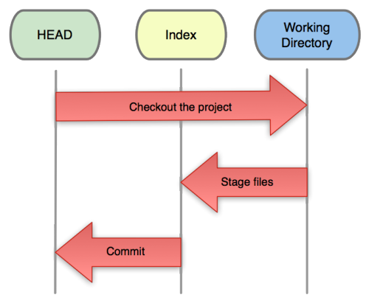
Getting Started
Three trees of Git
The HEAD
last commit snapshot, next parent
Index
Proposed next commit snapshot
Working directory
Sandbox

Slide 48
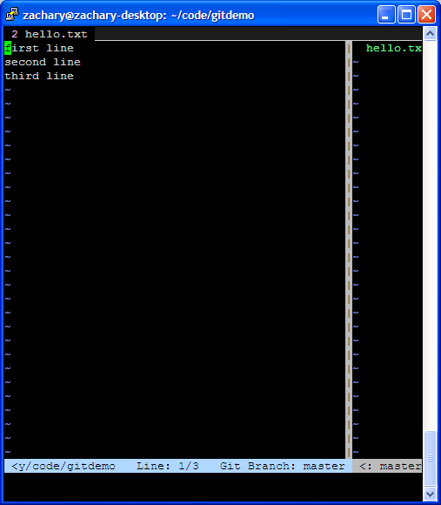
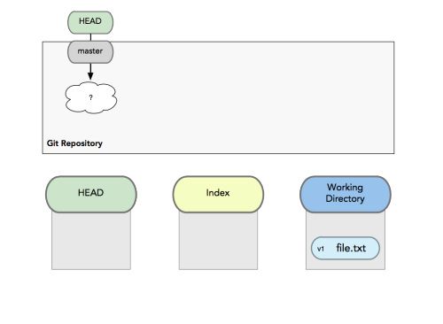
Getting Started
A basic workflow
Edit files
Stage the changes
Review your changes
Commit the changes
Use your favorite editor

Slide 49
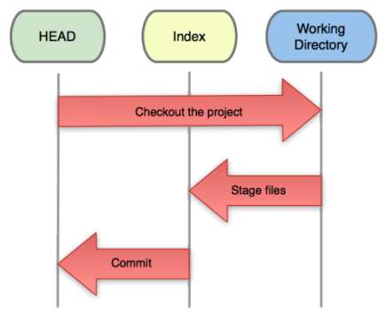
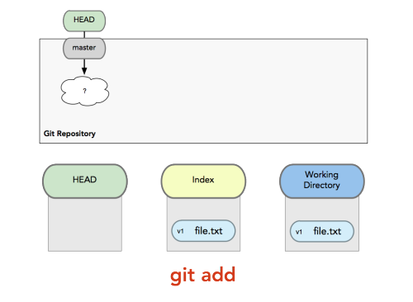
Getting Started
A basic workflow
Edit files
Stage the changes
Review your changes
Commit the changes
Git add filename
zachary@zachary-desktop:~/code/gitdemo$ git status
# On branch master
# Changes not staged for commit:
# (use "git add <file>..." to update what will be committed)
# (use "git checkout -- <file>..." to discard changes in working directory)
#
# modified: hello.txt
#
no changes added to commit (use "git add" and/or "git commit -a")

Slide 50
Getting Started
A basic workflow
Edit files
Stage the changes
Review your changes
Commit the changes
Git status
zachary@zachary-desktop:~/code/gitdemo$ git add hello.txt
zachary@zachary-desktop:~/code/gitdemo$ git status
# On branch master
# Changes to be committed:
# (use "git reset HEAD <file>..." to unstage)
#
# modified: hello.txt
#

Slide 51
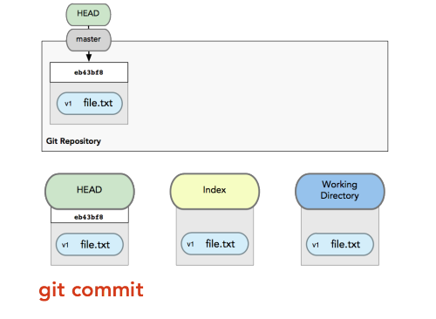
Getting Started
A basic workflow
Edit files
Stage the changes
Review your changes
Commit the changes
Git commit
# Please enter the commit message for your changes. Lines starting
# with '#' will be ignored, and an empty message aborts the commit.
# On branch master
# Changes to be committed:
# (use "git reset HEAD <file>..." to unstage)
#
# modified: hello.txt
#

Slide 52
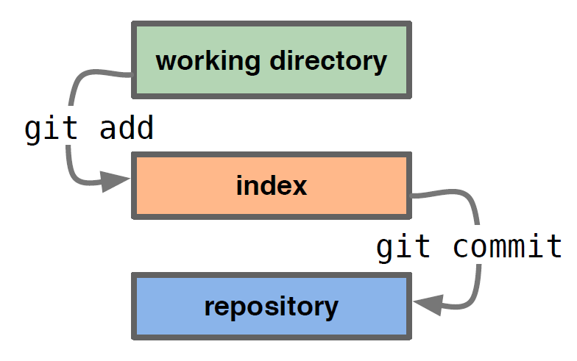
Getting Started
A basic workflow
Edit files
Stage the changes
Review your changes
Commit the changes
Basic workflow – short video: https://www.youtube.com/watch?v=eDRt9wI15mI

